Slide 1
Chapter 27
World War I and the Russian Revolution

Slide 2
Lesson 1: World War I Begins
As European countries formed alliances and increased the size of their militaries, they set the stage for global war
There were four MAIN causes of World War I

Slide 3
Causes of the War: Nationalism
Nationalism was causing both unification within countries and competition among nations
A rivalry developed between Europe’s Great Powers (Germany, Austria-Hungary, Great Britain, Russia, Italy, and France)

Slide 4
Causes of the War: Imperialism and Militarism
The quest for colonies (imperialism) also caused competition in Europe
By 1914, all of the Great Powers had large standing armies and engaged in militarism- the policy of glorifying military power and keeping an army prepared for war

Slide 5
Causes of the War: Alliances
Germany’s prime minister, Otto von Bismarck saw France as the greatest threat to peace
Bismarck formed the Dual Alliance between Germany and Austria-Hungary in 1879, and Italy joined in 1882 making the Triple Alliance
Bismarck also signed a treaty with Russia in 1881

Slide 6
Causes of the War: Alliances
Germany let the treaty with Russia lapse and Russia then formed an alliance with France
Germany began building a large navy, causing Great Britain to enter into an alliance with France and Russia in 1907, called the Triple Entente
By 1907 Europe has the Triple Alliance (Germany, Austria-Hungary, and Italy) and the Triple Entente (Great Britain, France, and Russia)

Slide 7
The Outbreak of War
On June 28, 1914 the heir to the Austrian throne, Archduke Franz Ferdinand and his wife were shot in Sarajevo, the capital of Bosnia
The assassin was Gavrilo Princip, a Serbian and member of the Black Hand, a secret society to rid Bosnia of Austrian rule

Slide 8
The Outbreak of War
Austria used the murder as an excuse to punish Serbia, a Russian ally
They issued Serbia several ultimatums to avoid war, and Serbia worked to negotiate
On July 28, 1914 Austria rejected negotiations and declared war on Serbia, beginning World War I

Slide 9
The Conflict Broadens
In response to Austria declaring war, Russia (Serbia’s ally) mobilized towards Austria and Germany
Germany declared war on Russia on August 1, 1914 and then on France two days later
Germany developed a plan for fighting a two-front war known as the Schlieffen Plan, which called for defeating France in the west and then rushing east to fight Russia
Great Britain then declared war on Germany

Slide 10
Lesson 2: World War I
By mid-August 1914, the Central Powers (Germany, Austria-Hungary, the Ottoman Empire, and Bulgaria) were pitted against the Allied Powers (Great Britain, France, Russia, Italy and Japan) and troops began marching off to war

Slide 11
The Western Front
By the fall of 1914, the war turned into a bloody stalemate in Northern France along the Western Front
When Germany lost the First Battle of the Marne to France on September 5, 1914, the Schlieffen Plan was ruined
The war turned to a stalemate and the Western Front became bogged down in trench warfare

Slide 12
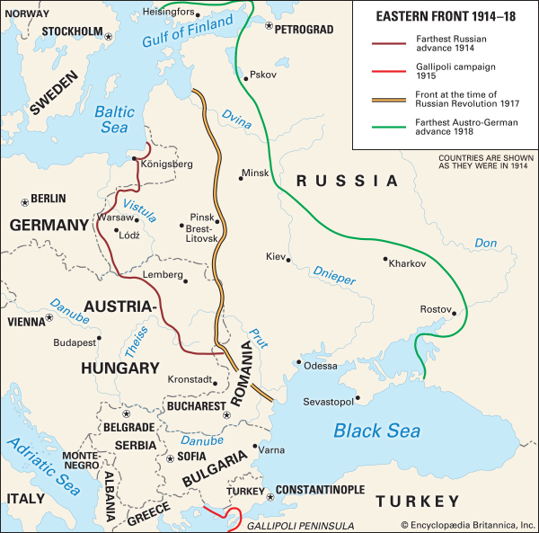
The Eastern Front
The Eastern Front was along the German/Russian border
Russia moved into Germany at the beginning of the war, but was quickly pushed back
Italy switched alliances and joined the Allied Powers in 1915
Russia sustained huge casualties, and German forces largely moved back west

Slide 13
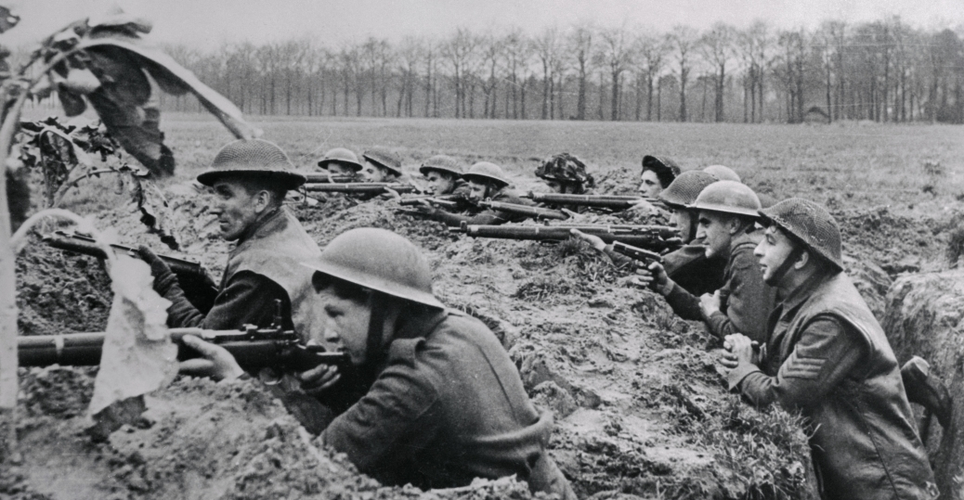
Trench and Air Warfare
By late 1914, both sides dug miles of trenches to protect against enemy fire, known as trench warfare
The space between trenches was known as “no-man’s land”
By the end of 1915, airplanes appeared on the battlefront, first used to spot enemy positions
Germans used zeppelins to bomb London and eastern England

Slide 14
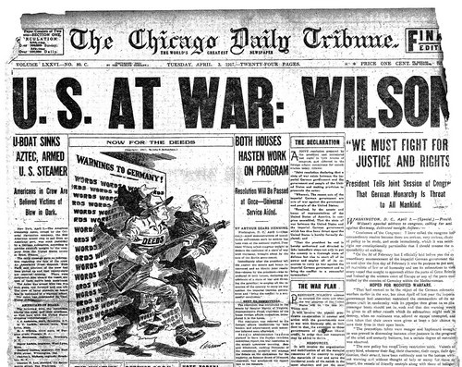
Entry of the United States
At first, the U.S. tried to remain neutral in the European conflict
Germany sank the Lusitania in 1915 under their policy of unrestricted submarine warfare with over 100 Americans on board
After Germany resumed submarine warfare and the Zimmerman note was intercepted in 1917, The United States declared war on Germany

Slide 15
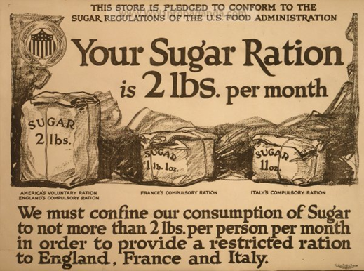
The Impact of Total War
World War I soon became a total war, meaning countries devoted all resources to the war effort
Factories produced munitions and equipment, and every citizen was put to work
Governments turned to rationing
In order to keep up morale, countries also produced propaganda to increase enthusiasm for the war

Slide 16
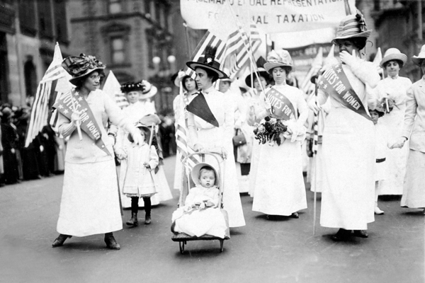
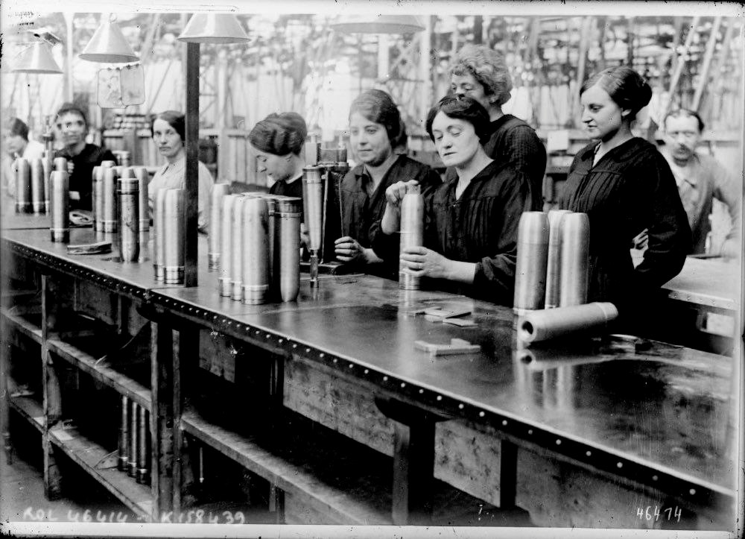
Total War and Society
In fall of 1918, a deadly strain of influenza emerged and 20 million people died worldwide
World War I also created new roles for women in the workforce
Even though many women left their jobs as men returned from war, the role women played had a positive effect on suffrage movements

Slide 17
Lesson 3: The Russian Revolution
As WWI dragged on, Russia struggled with unrest at home
The Romanov dynasty ended, and the Bolsheviks overthrew the government
By 1921, Russia was under complete control of the Bolsheviks

Slide 18
Background to Revolution
Russia was unprepared militarily and technologically for WWI
Czar Nicholas II insisted on taking charge of the military despite his lack of training
From 1914-1916, 2 million Russian soldiers were killed and 4-6 million were wounded
By 1917, many Russians wanted out of the war

Slide 19
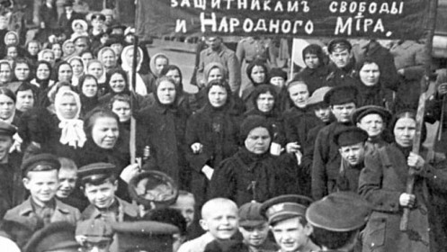
Background to Revolution
In March 1917, working-class women led strikes in Petrograd
They revolted after bread prices rose and rationing began
Nearly 200,000 workers swarmed the streets, and soldiers sided with the people

Slide 20
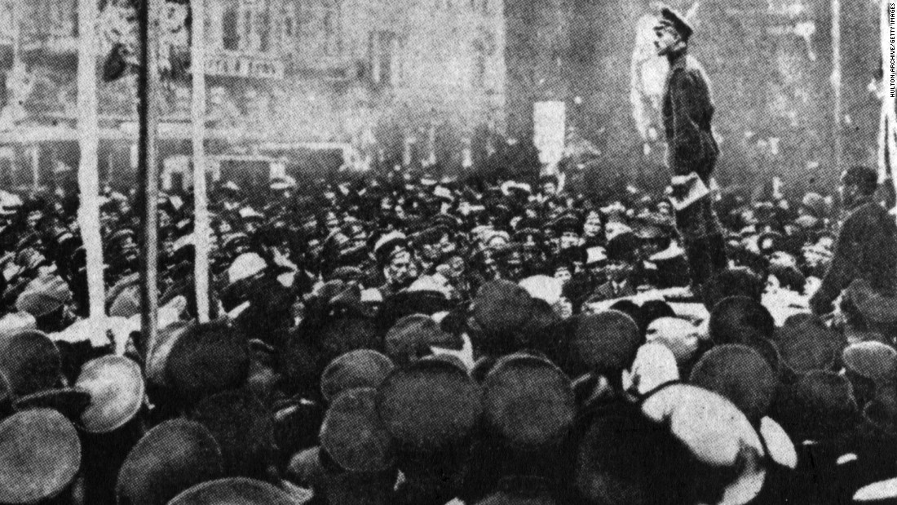
Background to Revolution
On March 12, 1917, the Russian parliament, or Duma, established a provisional government headed by Alexander Kerensky and the czar stepped down
Many Russians were unhappy with the decision to continue in WWI
Soviets, or local councils of workers, formed in many cities to represent the lower classes and began to challenge the government

Slide 21
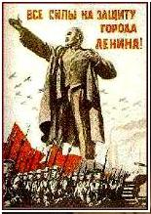
Lenin and the Bolsheviks
The Bolsheviks began as a small Marxist party led by Vladimir Ilyich Ulyanov, known as Lenin
The Bolsheviks were dedicated to violent revolution in order to destroy the capitalist system
Lenin moved to Germany to flee arrest, but Germany sent him back in 1917 to create disorder in Russia
Lenin’s arrival in Petrograd marked a new phase of the Russian Revolution

Slide 22
The Bolsheviks Seize Power
Bolshevik forces seized the provisional government’s winter palace in November 1917 with little bloodshed
On March 3, 1918, Lenin signed the Treaty of Brest-Litovsk with Germany to end its involvement in WWI

Slide 23
Civil War in Russia
Many people were opposed to the new Communist government, including the Allied Powers
The Allies send aid to the anti-Communists and from 1918-1921, the Red (Communist) Army fought the White (anti-Communist) Army in a bitter civil war

Slide 24
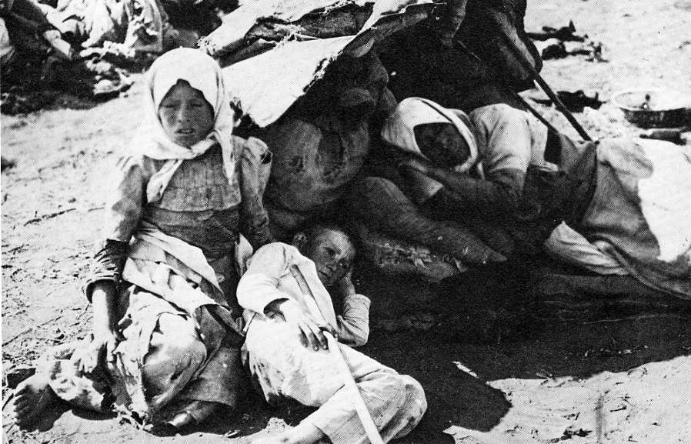
Triumph of the Communists
The Red Army won the civil war, as they were much more disciplined and unified than the White Army
Around 14 million Russians died in the conflict
The Bolsheviks now had to work to restore order to Russia after seven years at war and a devastating famine

Slide 25
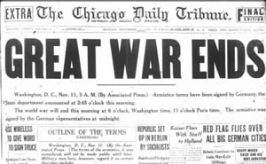
Lesson 4: World War I Ends
Shortly after the United States entered the war in 1917, Germany made its final gamble on the Western Front and lost
The war finally ended on November 11, 1918
New nations and a League of Nations was formed

Slide 26
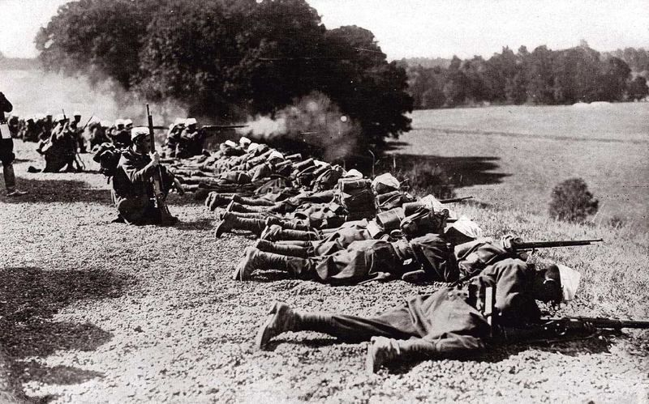
The Last Year of the War
The entry of the U.S. into WWI gave the Allies a huge psychological boost as well as fresh troops and supplies
With the Russians out of the war, Germany concentrated on the Western Front
Germany lost the Second Battle of the Marne in July 1918, ending their plans for victory
Germany signed an armistice to end fighting on November 11, 1918

Slide 27
Wilson’s Proposals
Woodrow Wilson, president of the United States, outlined “Fourteen Points” to the U.S. Congress for lasting peace
Wilson became a spokesperson for a new world order based on democracy and international cooperation

Slide 28
The Paris Peace Conference
Delegates met in Paris in early 1919 to determine the peace settlement following WWI
The most important decisions were made by The U.S., France, and Great Britain (the Big Three)
Germany was not invited and Russia was fighting their civil war
The League of Nations was created in January 1919

Slide 29
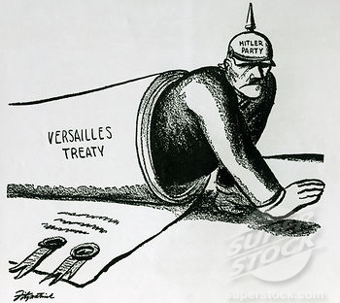
The Treaty of Versailles
The Treaty of Versailles between Germany and the Allied powers was signed June 28, 1919
Germany lost territory and gained severe military restrictions
Through Article 231, or the “war guilt clause”, sole responsibility for the war was placed on Germany
Germany had to pay reparations to the Allies and their colonies were taken away

Slide 30
The Legacies of the War
German and Russian empires lost considerable territory, and the Austro-Hungarian empire disappeared
New European states emerged from these lands
The Ottoman Empire was also broken up
World War I caused almost 10 million deaths and undermined the ideas of progress prevalent in the world before 1914

