Slide 1
Chapters 31 and 33
Reconstructing the Postwar world/ The cold War

Slide 2
Allies become enemies
Even before the end of WWII, the U.S. alliance with the Soviet Union had begun to unravel
The U.S. was still upset with the Soviet/German non-aggression pact and Stalin blamed the allies for not invading German-occupied Europe sooner

Slide 3
Yalta conference: a postwar plan
In February 1945, leaders of the U.S., Britain, and the Soviet Union met at the Soviet Black Sea resort of Yalta
They agreed to divide Germany into zones of occupation controlled by Allied military forces
Stalin agreed to join the forces against Japan and promised free elections in Eastern Europe

Slide 4
Creation of the united nations
In June 1945, the Soviet Union, U.S., and 48 other nations formed the United Nations
The U.N. was intended to protect its members against aggression and it was to be based in New York

Slide 5
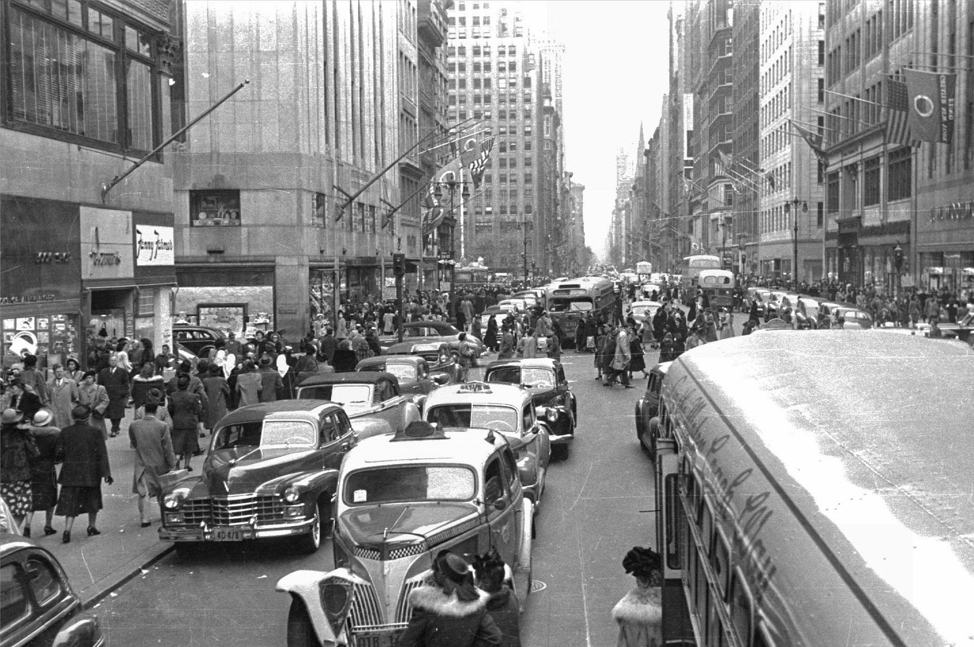
Differing U.S. and Soviet Goals
The U.S. and the Soviet Union split sharply after WWII
The Soviets had 50x as many fatalities as the U.S. and many Soviet cities were demolished
This along with differing political and economic situations affected their postwar goals

Slide 6
Eastern Europe’s iron curtain
A major goal of the Soviet Union was to shield itself from another invasion from the west
Stalin ignored the Yalta agreement and installed communist governments in 7 Eastern European countries as a buffer zone
In early 1946, Stalin declared that communism and capitalism could not exist in the same world

Slide 7
An iron curtain divides east and west
Germany was now split into two sections, and the Soviets controlled the eastern part including Berlin
Churchill’s phrase “iron curtain” came to represent Europe’s division into democratic Western Europe and communist Eastern Europe

Slide 8
United States tries to contain soviets
U.S.-Soviet relations continued to worsen in 1946 and 1947
President Truman adopted a foreign policy called containment- it was directed at blocking Soviet influence and the spread of communism

Slide 9
The Truman doctrine
Truman’s support for countries the rejected communism was called the Truman Doctrine
The U.S. congress authorized more than $400 million in aid to countries threatened by communism such as Turkey and Greece

Slide 10
The Marshall plan
In 1947, the U.S. Secretary of State, George Marshall proposed that the U.S. give aid to needy European countries
This assistance program, the Marshall Plan, would provide materials to rebuild Western Europe

Slide 11
The berlin airlift
The U.S. and the Soviets clashed over how to handle Germany- the Soviets wanted to keep the country weak and divided
In 1948, the allies decided to withdraw and allow their occupation zones to form one nation, but the Soviets responded by holding Berlin hostage
American and British officials flew food and supplies in for 11 months until the Soviets lifted the blockade in May 1949

Slide 12
The Cold war divides the world
These conflicts marked the start of the Cold War between the United States and the Soviet Union
Beginning in 1949, the superpowers used spying, propaganda, diplomacy, and secret operations in dealing with each other
Much of the world allied with one side or the other

Slide 13
Superpowers form rival alliances
In 1949, ten Western European nations, the U.S., and Canada form a defensive military alliance called the North Atlantic Treaty Organization, or NATO
The Soviet Union formed its own alliance in 1955 called the Warsaw Pact
In 1961, the East Germans built a wall to separate East and West Berlin

Slide 14
The threat of nuclear war
In 1949, the Soviet Union exploded its own atomic weapon
Dwight D. Eisenhower became the U.S. president in 1953
The U.S. and the Soviet Union began an arms race that would go on for four decades, and began to engage in brinkmanship, or the willingness to go to the brink, or edge of war

Slide 15
The cold war in the skies
The Cold War affected the science education programs in the two countries
In August 1957, the Soviets launched Sputnik, the first unmanned satellite
In 1958, the U.S. launched its own satellite
In May 1960, the Soviets shot down a high-altitude U.S. plane and its pilot was captured, heightening tensions

Slide 16
War in Korea
When World War II ended, Korea became a divided nation
North of the 38th parallel, Japanese troops surrendered to Soviet forces and this area became the communist industrial north
South of this line, the Japanese surrendered the American troops and this area became the non-communist rural south

Slide 17
Standoff at the 38th parallel
On June 25, 1950, North Koreans (aided by Soviet money and weaponry) launched a surprise attack on South Korea
A total of 15 U.N. nations, including the U.S. and Britain, intervened under the command of General Douglas MacArthur

Slide 18
Standoff at the 38th parallel, cont.
By September 1950, the North controlled the entire peninsula except a small area around Pusan in the Southeast
That month, MacArthur launched a surprise attack and that, along with a U.S. Marine strike, caused about ½ of the North Korean troops to surrender and the rest retreated

Slide 19
The fighting continues
When the U.N. troops pushed the North Korean forces almost into China, the Chinese sent 300,000 troops into North Korea
By January 1951, the outnumbered U.N. forces were pushed out of North Korea
The Chinese then moved into South Korea and captured the capital of Seoul

Slide 20
The fighting continues, cont.
General MacArthur called for a nuclear attack against China, but Truman disagreed and removed him
Finally, in 1953, U.N. forces and North Korea signed a cease-fire and the border between North and South Korea was set near the 38th parallel
4 million soldiers and civilians died

Slide 21
Aftermath of the war
After the war, Korea remained divided, separated by a demilitarized zone
The North remained communistic with serious economic problems and developed nuclear weapons
The South prospered, thanks in part to aid from the U.S. and other countries

Slide 22
War Breaks out in Vietnam
Much like the Korean War, the involvement of the U.S. in Vietnam stemmed from its Cold War containment policy
After WWII, stopping the spread of communism was the main goal of U.S. foreign policy

Slide 23
The road to war
In the early 1900s, France controlled Vietnam
During the 1930s, a young nationalist, Ho Chi Minh, turned to the communists for help in revolting against the French
The Japanese seized control of Vietnam in 1940, but were forced out after their defeat in 1945 and France wanted to regain its colony

Slide 24
The fighting begins
Vietnamese nationalists and communists joined to fight the French
In 1954, the French surrendered to Ho Chi Minh
With the defeat of the French, the U.S. feared that a communist Vietnam could cause other Asian countries to fall to communism- this became known as the domino theory

Slide 25
Vietnam- a divided country
Vietnam was divided at the 17˚ north latitude
The north was communist and ruled by Ho Chi Minh and the south was ruled by an anti-communist government under the leadership of Ngo Dinh Diem
Diem ruled the south as a dictator, and communist guerillas backed by the north called Vietcong began to gain strength

Slide 26
The United States gets involved
Faced with the possibility of a Communist victory, the U.S. decided to increase its involvement in Vietnam
They steadily increased troops and supply shipments to Vietnam

Slide 27
U.S. troops enter the fight
In August 1964, Congress authorized the president to send U.S. troops to fight in Vietnam
By 1968, more than 500,000 U.S. soldiers were in combat there
U.S. planes also began to bomb North Vietnam

Slide 28
U.S. troops enter the fight, cont.
The U.S. had two main problems in Vietnam:
U.S. soldiers were fighting a guerilla war in unfamiliar jungle terrain, and
The South Vietnamese government they were defending was becoming more unpopular and support for the Vietcong was growing

Slide 29
The United States Withdraws
During the late 1960’s, the war grew increasingly unpopular in the U.S., and protests began
President Nixon began withdrawing troops from Vietnam in 1969
He had a plan called Vietnamization, which allowed for U.S. troops to gradually pull out while the south increased their combat role
The last U.S. troops left in 1973
More than 1.5 million Vietnamese and 58,000 Americans died in the Vietnam War

Slide 30
Cambodia in Turmoil
In 1975, communist rebels known as the Khmer Rouge set up a brutal government under the leadership of Pol Pot
They slaughtered 2 million people in an attempt to transform Cambodia into a Communist society

Slide 31
Vietnam after the war
After 1975, the victorious North Vietnamese imposed tight controls on the South
Communist oppression caused 1.5 million people to flee Vietnam
The U.S. normalized relations with Vietnam in 1995, and today the country (while still communist) welcomes foreign investment

Slide 32
Fighting for the third world
Following WWII, the world’s nations were grouped into three “worlds”
The Third World consisted of developing nations, often newly independent, who were not aligned with the U.S. or Soviet Union

Slide 33
Cold war strategies
The U.S. and the Soviet Union used a variety of techniques to gain influence in the Third World
They backed wars of revolution and gave aid to several countries
The CIA and the KGB (Soviet intelligence agency) engaged in secret activities against each other

Slide 34
Association of Nonaligned nations
Not all third world nations wished to play a role in the Cold War
In 1955, Indonesia hosted leaders from Africa and Asia at the Bandung Conference
They met to form a “third force” of independent countries, or nonaligned nations

Slide 35
Confrontations in Latin America
After WWII, rapid industrialization, population growth, and a large wealth gap led Latin American nations to seek aid from both superpowers
The Soviet Union often backed revolutionary movements in these countries and the U.S. backed anti-Communist dictators

Slide 36
Fidel Castro and the Cuban Revolution
In the 1950’s, Cuba was ruled by an unpopular dictator, Fulgencio Batista
A lawyer named Fidel Castro led a revolution in 1959 which overthrew Batista
Castro became a harsh dictator and allied with the Soviets for economic and military aid
In April 1961, the U.S. invaded Cuba at the Bay of Pigs and suffered a humiliating defeat

Slide 37
The Cuban missile crisis
In July 1962, Nikita Khrushchev, the leader of the Soviet Union, secretly began to build 42 missile sites in Cuba
U.S. president John F. Kennedy declared that missiles so close to the U.S. mainland were a threat and demanded their removal
The world feared nuclear war, but Khrushchev removed the missiles in return for a U.S. promise to not invade Cuba

Slide 38
Confrontations in the middle east
Throughout the Middle East, oil industry wealth fueled a growing clash between traditional Islamic values and modern Western Materialism
This area attracted both superpowers because of its rich natural resources

Slide 39
Secular rule in Iran
By the late 1950’s, Iran was led by Shah Mohammed Reza Pahlavi, who westernized the country
The shah tried to weaken the influence of Iran’s conservative Muslim leaders, known as ayatollahs
Ayatollah Ruholla Khomeini spurred riots to break out in Iran in 1978, and the shah fled in 1979, leaving Khomeini in power

Slide 40
Khomeini’s anti-U.S. policies
In 1979 with the ayatollah’s blessing, Islamic revolutionaries seized the U.S. embassy in Tehran, taking more than 60 Americans hostage for 444 days in the Iran Hostage Crisis
War broke out between Iran and Iraq in 1980 because of Iraq’s secular policies and continued until 1988, costing 1 million lives

Slide 41
The superpowers face off in Afghanistan
The Soviet Union invaded Afghanistan in 1979 to put down a Muslim revolt
Similar to Vietnam, the Soviets found themselves fighting a guerilla war in unfamiliar territory
Supplied with American weapons, the mujahedeen, or holy warriors, fought on and the Soviets withdrew in 1989

Slide 42
Soviet policy in eastern Europe and china
After Stalin’s death, more moderate Soviet leaders came to power and allowed their satellite countries more independence
During the 1950’s and 1960’s, growing protest movements in Eastern Europe threatened Soviet control in the region

Slide 43
Destalinization
After Stalin’s death in 1953, Nikita Khrushchev became the dominant Soviet leader
He started a policy called destalinization, or purging the country of Stalin’s memory and working more peacefully with capitalist states
Many satellite countries began to protest Soviet rule

Slide 44
The revolt in Czechoslovakia
In 1964, Khrushchev was replaced by Leonid Brezhnev as Soviet leader
Brezhnev was a brutal dictator and invaded Czechoslovakia in 1968 when their leader, Alexander Dubček loosened controls on censorship during the Prague Spring

Slide 45
Brinkmanship breaks down
After the Vietnam war, the U.S. backed away from its policy of confrontation with the Soviet Union
Under Richard Nixon, détente, a policy of lessoning Cold War tensions, replaced brinkmanship
This grew out of a philosophy known as realpolitik, meaning “realistic policies”

Slide 46
Nixon visits communist powers
In 1972, Nixon visited both China and the Soviet Union
After a series of meetings called the Strategic Arms Limitation Talks (SALT), Nixon and Brezhnev signed the SALT I treaty, limiting nuclear weapons

Slide 47
Reagan takes an anti-communist stance
Under presidents Nixon, Ford, and Carter the U.S. improved relations with the Soviet Union
Ronald Reagan took office in 1981 and put economic and military pressure on the Soviets
The Soviet Union collapsed in 1991

