Slide 1
The Reformation in Europe
Chapter 16

Slide 2
Lesson 1: The protestant reformation
The rise of the Renaissance along with perceived corruption in the Catholic Church led to a call for church reform that split the Christian Church into two parts: Catholics and Protestants

Slide 3
Christian humanism
As a result of the Renaissance, a movement called Christian Humanism developed to reform the Catholic Church
Desiderius Erasmus was the best-known Christian Humanist- wrote The Praise of Folly, criticizing religion of the time

Slide 4
Need For Reform
Many people were upset with the Catholic Church’s policies, as well as preoccupation of the Church leaders with politics and worldly interests
The church was selling indulgences, or pardons for sin, to ensure people’s salvation

Slide 5
Martin Luther
Martin Luther was a Catholic monk and professor
Luther disagreed with the Catholic Church that faith AND good works were needed for salvation- he thought only faith was
This idea was called justification by faith alone

Slide 6
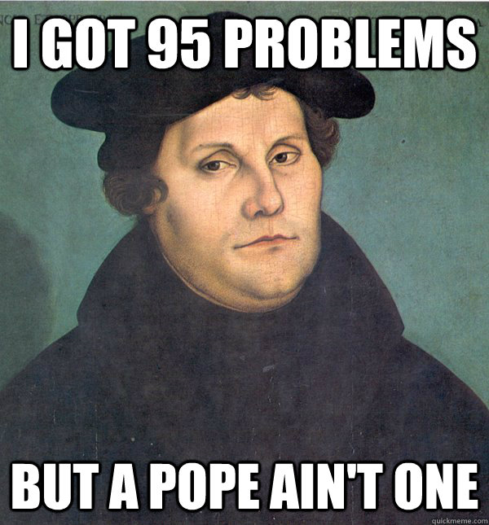
The 95 Theses
In 1517, Luther posted a list of grievances against the church, called the 95 Theses, on a church door in Wittenberg
Thousands of copies were printed and distributed throughout Europe, increasing discontent with the Catholic Church

Slide 7
A Break with the church
Luther continued to argue that faith alone brings salvation, as well as that there should be only two sacraments, and that church clergy should marry
The pope excommunicated Luther in 1521, and he was made an outlaw within the Holy Roman Empire at the Diet of Worms
Luther went into hiding and was later protected by Frederick III, the prince of Saxony

Slide 8
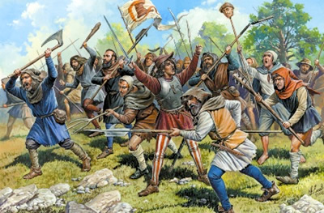
The Rise of Lutheranism
Luther gained support of many German rulers in the Holy Roman Empire, and many converted Catholic churches in their states to Lutheran churches
In 1524, there was a peasant revolt against the German princes, and Luther backed the princes causing many to go back to the Catholic faith

Slide 9
Politics in the German Reformation
Charles V, the Holy Roman Emperor, ruled an immense empire that maintained power largely because of the Catholic Church
The Reformation caused a war between Charles V and the German princes, in which Charles V lost
1555- Peace of Augsburg declared each German ruler could choose which religion their people practiced

Slide 10
Lesson 2: The Spread of Protestantism
In the 1500’s, different forms of Protestantism began and spread, including Lutheranism, Calvinism, Anglican, and Anabaptist
The Catholic Church underwent a reformation as well

Slide 11
Protestantism in Switzerland
John Calvin (author of Institutes of Christian Religion) became the Protestant leader of Switzerland after fleeing France
He began the Calvinist church, which believed in the doctrine of predestination, and ruled the city of Geneva, Switzerland
Calvinism quickly spread throughout Europe

Slide 12
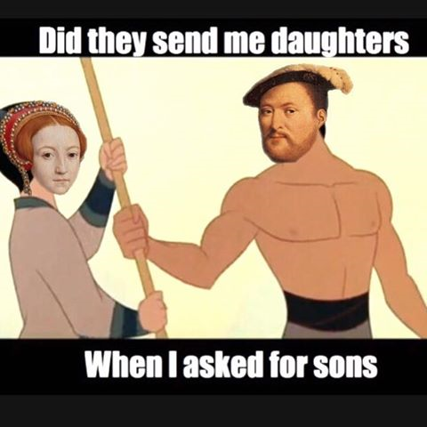
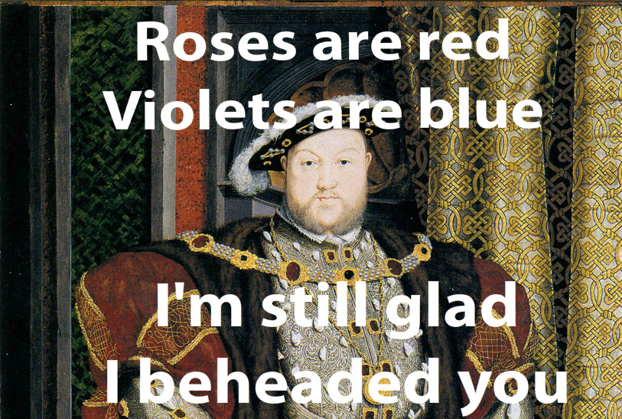
Reformation in England
King Henry VIII wanted to divorce his wife (Catherine of Aragon) because he did not have a male heir
He asked the pope for an annulment so he could marry Anne Boleyn
The pope refused, and Henry broke from the Catholic Church to begin the Church of England, or Anglican Church
Act of Supremacy of 1534- declared the king was the head of the church and state

Slide 13
Anabaptists
Anabaptists were radical Protestants who believed the state should not play a role in religion at all
Anabaptists believed in only adult baptism, and believed all members of the church to be equals
Anabaptists were widely persecuted by other Protestants and Catholics alike

Slide 14
Reformation and Society
The Protestant Reformation effected education in Europe, incorporating humanist methods, as well as establishing public schools
Protestantism also encouraged marriage, as well as traditional male-female gender roles
However, Anti-Semitism remained common in Europe

Slide 15
Catholic Reformation
The Catholic Church was revitalized in the 1500’s because of three elements:
The Jesuits- founded by Ignatius of Loyola. Spread Catholicism by missionaries and schools
Reform of the papacy- Pope Paul III changed the corruption of the church
Council of Trent- group of Catholic leaders who met to define church doctrine

